Slide 1
Diversity and Antiracism in Piano Teaching
Dr. Stephen Lewis, NCTM
Member, East Portland District, OMTA

Slide 2
Purpose and Intention
My background
  White, straight, cis-gendered, male, WASP, had access to excellent education
  Agent Rank in all areas of the ADRESSING model (more on this later)
Complex and difficult issues
Emotionally painful ideas to contemplate
Provide tools, ideas, and resources for healing, compassion, and growth

Slide 3
Context
This talk is based on the situation in the United States.
  Other nations have different versions of these problems than we do.
Speaking to issues faced by music teachers, not famous musicians, prominent artistic organizations, or the recording industry.

Slide 4

Scary Headlines, Social Posts, and Tweets
In the past few years, we all have probably encountered ideas like:
  #cancelBeethoven
  “Classical music has a whiteness problem.”
  “There are too many white people in the piano world.”
Even if our own views are very progressive, as musicians trained in classical music who love classical music, these ideas can feel very threatening and painful.

Slide 5
Music and Identity
The music we love is an important part of how we constitute our own sense of identity.
It often feels like Beethoven’s music is a part of me.
When a part of our identity seems to be under attack, we feel like we are under attack ourselves.
This is known as fusion, a psychological term referring to over-identification with something external to our true selves.
In reality, Beethoven’s music is separate from my true self despite my fusion with it.

Slide 6
Music and Identity
It can be especially painful when something we love and are fused to is called out for being racist or misogynist.
  My sense of identity is fused with Beethoven’s music, and Beethoven’s music is being called out as part of white supremacy. Therefore, through my fusion, I feel as though I am being called a racist.
It is important to take steps to de-fuse ourselves so that we can listen and understand what is really being communicated by others.
This is difficult yet rewarding; I myself am only partway along my own journey and my intention is to speak with all of you in the spirit of compassion.

Slide 7
My Background and Awakening
Growing up in the politically correct, self-congratulatory 1990s
History as a classical music supremacist
Confrontation at African Heritage Dining Hall on 9/10/2001, followed the next day by 9/11
This American Life episode on the Trail of Tears
Being fired for speaking out against the War in Iraq

Slide 8
Antiracism Definitions
“Racism is a powerful collection of racist policies that lead to racial inequity and are substantiated by racist ideas. Antiracism is a powerful collection of antiracist policies that lead to racial equity and are substantiated by antiracist ideas.” Ibram X. Kendi, How to Be an Antiracist, p. 20
“There is no such thing as a nonracist or race-neutral policy. Every policy in every institution in every community in every nation is producing or sustaining either racial inequity or equity between racial groups.” Ibram X. Kendi, How to Be an Antiracist, p. 19

Slide 9
Anti-misogyny
A definition of anti-misogyny can follow a very similar form to the definition of antiracism:
  “Misogyny is a powerful collection of misogynist policies that lead to gender inequity and are substantiated by misogynist ideas. Anti-misogyny is a powerful collection of anti-misogynist policies that lead to gender equity and are substantiated by anti-misogynist ideas.” - adapted from Kendi
Anti-misogyny is essentially feminism, though as a term it more easily includes people who are neither cis-men nor cis-women, such as those who are transgender or intersex.
Anti-misogyny is to male supremacy as antiracism is to white supremacy.

Slide 10
Skills Development
Excellent resource: Beyond Inclusion, Beyond Empowerment: A Development Strategy to Liberate Everyone by Leticia Nieto, Margot F. Boyer, Liz Goodwin, Garth R. Johnson, and Laurel Collier Smith (hereafter abbreviated to BIBE)
Three layers of social interaction:
  Power (inherent personal power)
  Rank (social roles and hierarchies)
  Status (moment-to-moment interactions)

Slide 11
Rank: ADRESSING Model
Rank roles are fixed and repeat from one context to another.
  Rank roles are different in different cultures and nations.
  Rank roles can change, but only very slowly and over very long timespans.
  This model describes the modern United States.
Two central roles: Agent and Target
Agent ranks are positively reinforced, and “receive affirmation and support and have ready access to rewards.” BIBE, p. 30.
Target ranks “are devalued and ‘otherized.’” BIBE p.30

Slide 12
Rank: Key Point
Rank roles dehumanize EVERYONE.

Slide 13
Social Rank Category | Agent Rank | Target Rank
Age | Adults (18-64) | Children, Adolescents, Elders
Disability | Able-persons | Persons with Disabilities
Religion (relates to religious culture) | Cultural Christians, Agnostics, and Atheists | Jews, Muslims, and all other non-Christian religions
Ethnicity | White Euro-Americans | People of Color
Social Class Culture | Middle and Owning Class (access to higher education) | Poor and working class (no access to higher education)
Sexual Orientation | Heterosexuals | Lesbians, gay men, bisexuals, queer, and questioning
Indigenous Heritage | Non-Native | Native
National Origin | U.S.-born | Immigrants and Refugees
Gender | Biologically Male | Female, Transgender, and Intersex
Table from
BIBE, p. 30

Slide 14
Rank Membership
Myself
I am Agent Rank in all categories: Adult, Able-bodied, Cultural Christian, White, Middle Class, Straight, Non-Native, U.S.-born, and Biologically Male
My middle-school piano teacher
She is Agent rank in some categories and Target in others
Agent: Age, Able-bodied, Religion, Ethnicity, Sexual Orientation, Heritage, and National Origin
Target: Social Class and Gender

Slide 15
Agent and Target Skills
What do we do with our knowledge of our various ranks?
Skills: A toolset for working effectively against oppression
  “to help people assess their own consciousness and behavior, and that of others, in order to make strategic interventions.” BIBE p. 95
“These models can help us to stay in relationship with people who have different consciousness, social memberships, and experiences – and also to recognize the potential for growth in ourselves and others.” BIBE p. 95
Skills are progressive and develop over time
  Skills are not “stages”; we continue to use all of our available skills at various times

Slide 16
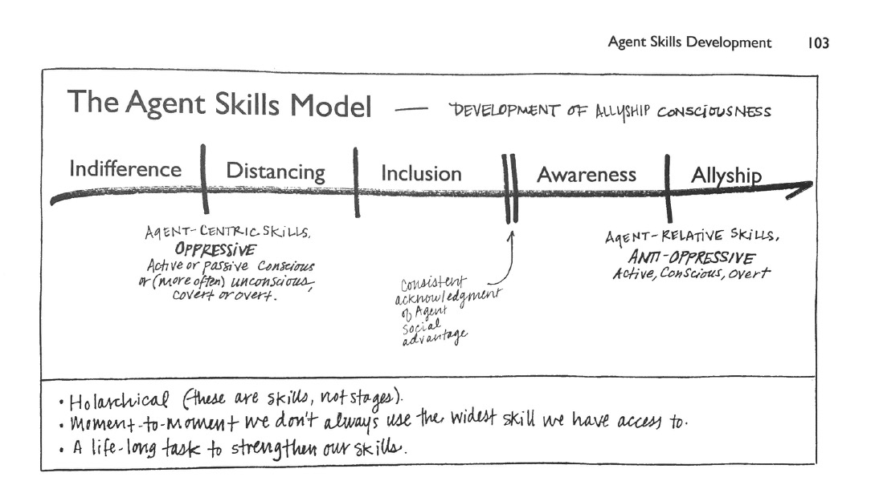
The Agent Skills Model

Slide 17
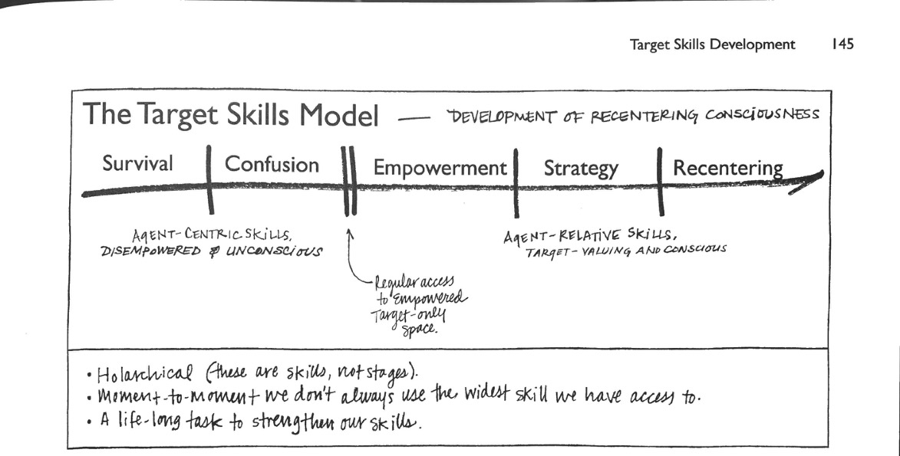
The Target Skills Model

Slide 18
Agent Skills
I will focus on Agent Skills in this talk.
Most of us here have at least one Target rank, but we are all teachers, and teachers hold Agent rank over students (of any age) who are Target rank.

Slide 19
Indifference
“not recognizing differences or oppression because of isolation or intentional separation from Targets.” BIBE p. 103
Main purpose: to preserve one’s energy
Examples: “I don’t know any music by black/women/non-European composers” or “I didn’t know that there were any Mexican classical piano composers.” or “I just teach what I already know.”

Slide 20
Distancing
“…pushing away. We are pushing away contact. We are pushing away knowledge and consciousness. We are especially pushing away the implications about ourselves that the contact and consciousness would raise.” BIBE p. 107
Distancing down example: “Music by black/women/non-European composers is fine enough, but not appropriate for teaching real skills.”
Distancing up example: “Classical music is serious and great; jazz is fun!”

Slide 21
Inclusion
“…we use our selective perception to emphasize what we have in common with members of Target groups.” BIBE p. 115
Inclusion can often feel very progressive and open-minded for people with Agent rank.
However, Inclusion is always on the Agent’s terms; the Agent maintains the Rank system while being inclusive and is ready to reject any Target rank people who “rock the boat”.
Inclusion examples: “I’m already one of ‘the good ones’; after all, I teach Scott Joplin and Clara Schumann.”

Slide 22
Awareness
“Awareness is about the realization of unearned privilege and unfair advantage operating all of the time in our favor as members of Agent social groups.” BIBE p. 121
“Using Awareness, we notice the reality of Agent privilege, and we begin to contemplate how that privilege has provided us with benefits all our lives. We often feel paralysis as we reflect on the reality of oppression and our own unearned privilege. The ability to tolerate these uncomfortable feelings is essential to developing and holding Awareness.” BIBE p. 122

Slide 23
Awareness
Awareness examples: “I just can’t forget about how Robert Schumann forced his wife Clara to stop composing in order to be a mother. I still love Robert’s music, but whenever I hear it I also think of how he treated Clara and it is uncomfortable for me now.”
“I love Debussy, but I just can’t feel comfortable with his music that celebrates racist minstrel shows like “Gollywog’s Cakewalk”, “Minstrels”, or “Le petite negrè”. The last one I can’t even say out loud in English because it is a racial slur!”

Slide 24
Allyship
“Allyship is Awareness plus action.” BIBE p. 127
“Allyship allows us to use the privileges that accompany our Agent Rank on behalf of justice and liberation for everyone.” BIBE p. 127

Slide 25
Allyship
Allyship examples: “When I perform Debussy’s Preludes, book 1, I will omit “Minstrels” and instead invite a local Black Lives Matter activist to use that time onstage to address and educate my audience about systemic oppression.”
“I will put more effort into finding alternative teaching pieces to ‘Gollywog’s Cakewalk’ and ‘Minstrels’, especially since there are many works with similar musical elements and teaching goals by black composers.”

Slide 26
Skills are Holarchical
Holarchical: a state where various parts and the whole overlap without hierarchy or teleology
As we develop all of these skills, we will continue to use all five at different times.
This is okay because none of us is full of unlimited energy
Nobody is useful if we burn ourselves out

Slide 27
Antiracist Ideas: What and How
Two primary approaches
  Increase the presence of music by diverse composers and/or styles in our teaching
  Transform how we frame the music by the famous composers of the “canon”

Slide 28
Increasing Diversity
Challenges:
  Due to historical systemic oppression of non-white and non-male composers, there simply is not the same breadth of possible music to teach from the 17th, 18th, and 19th centuries by non-white, non-male, non-European composers
    Furthermore, what music there is is often unpublished or out of print
  Similarly, composers from these oppressed groups tended towards other musical activities that are less useful for teaching classical piano
    Many focused on their performing
    As composers, many moved towards other genres (jazz, folk, popular music) that are their own separate disciplines

Slide 29
Increasing Diversity
Challenges, continued:
  Much of the classical music composed by oppressed composers is from the 20th and 21st centuries and is often quite difficult to play (beyond level 10) and/or is in very modern, often atonal styles
    Even if you like thorny, dissonant modern music (which I sure do!), it is music for truly advanced students only in most cases
  It is important to avoid tokenism when introducing music by oppressed composers

Slide 30
Tokenism
Tokenism is a shallow or perfunctory effort to be inclusive.
  It can refer both to the quantity of inclusion and the framing of such inclusiveness.
Classical piano music’s history of exclusion of non-white, non-male, non-European composers, makes it difficult to reach a parity of representation
Because of this, it is even more important that music by oppressed composers be included in thoughtful, meaningful ways

Slide 31
Selected Scores for Teaching Music By Historically Oppressed Composers
(note: all the music here is intermediate or harder)
Women Composers in History: 18 Intermediate to Late Intermediate Piano Pieces by 8 Composers. Gail Smith, editor. Published by Hal Leonard.
Black Woman Composers: A Century of Piano Music (1893-1990). Helen Walker-Hill, editor. Published by Hildegard Publishing Company (www.hildegard.com).
American Women Composers: Piano Music from 1865-1915. Sylvia Glickman, editor. Published by Hildegard Publishing Company (www.hildegard.com).
Piano Music of Africa and the African Diaspora, vol. 1-5. William H. Chapman Nyaho, editor. Published by Oxford University Press.
Vol. 1 is intermediate, Vol. 2 late intermediate, Vol. 3 early advanced, Vols. 4 and 5 advanced.

Slide 32
How We Frame Music Matters
Racist/misogynistic/colonialist ideas hide and are often disguised as other types of ideas, such as
  Common sense
  Historical “facts”
  Aesthetic or ontological assertions

Slide 33

Examples
Music is a universal language.
Beethoven is “great”, or a “genius”.
Absolute music is superior to program music.
Clara Schumann/Scott Joplin are good, but there’s just something greater about Beethoven/Chopin/Debussy.
Classical music is better/more important/more beautiful than jazz/popular/folk/”world” music.
Classical music is not compromised by commercialism or agendas.

Slide 34
Music as Universal Language
When we say this, we are implying:
  “Music” means Western classical/tonal music, excluding other musics
  “Language” means that music should make sense easily to everyone and mean the same things, excluding those from other cultures and those with less education
  “Universal” excludes everything that is challenging to understand as “not music”
  “Universal” excludes women, non-white people, and non-Europeans

Slide 35
Music as Universal Language
How we should talk about this instead
  Musical style and harmonic systems are different from culture to culture
  No musical culture is superior to any other culture
  Musical understanding is learned like our spoken languages (which also feel “natural” to us)
  Western music seems “universal” because of the legacy of colonialism having spread this music around the world, often in explicit reeducation schools and camps
  The effects of colonialism have been extended by globalization and the ubiquity of Western popular music and Western film music

Slide 36
Music as Universal Language
Who controls what music means?
  Example: Beethoven’s Fifth Symphony is commonly understood to be about “overcoming fate”.
  This meaning was created by various white European and American men over the 19th century and favors their perspectives and interests.
  Any musical experience means different things for different people and indeed never cannot do so.
  Music is a communal experience with individual interpretations.

Slide 37
Music as Universal Language
Way forward: Allow for diverse and divergent interpretations of music, especially from any students from Target Rank groups.
  The “emotion” in music is really affect: a depiction of an emotion. Our reaction to affect can vary widely based on our own personal experiences.
  Unless we are hearing impaired, we are all receiving the same sound waves, but the stuff in our heads and in our histories will lead to us have very different reactions to music.
  Resist “correcting” your students about what they feel or understand about music.

Slide 38
Music as Universal Language
Way forward: When discussing the meaning of music, put things in “I” statements rather than objective statements.
  Example: “When I hear Chopin’s “Revolutionary” Étude, I feel that it is expressing Chopin’s feelings of loss and anger over Russia invading Poland.” rather than “Chopin’s “Revolutionary” Étude is about Chopin’s loss and anger over Russia invading Poland.”
  You may think that some meanings are “objective”, but, as a composer, I can tell you that you can never really know what a composer’s inspiration or intention is.

Slide 39
Greatness and Genius
At first glance, it might seem like an honor to consider someone Great or a Genius.
However, this idea is exclusionary because it supposes that some people can be so exceptional that no one else can reach their level.
The vast majority of Great People are white men.
The Cult of Greatness, the Cult of Genius, dehumanizes those we think of as Great.

Slide 40
Greatness and Genius
Greatness or Genius as an idea hides all the ways in which these people have depended upon the work and support of others in their accomplishments.
The further down the Rank ladder someone is, the less likely they are to be considered part of the Great person’s success.
Example: Without the people who milked cows and reaped harvests around Vienna, Beethoven would have starved to death.

Slide 41
Greatness and Genius
Real justice lies in changing the unjust system, not replacing those who benefit by it.
Example: it is not a feminist victory if a corporation that exploits its female workers appoints a woman as CEO.
Example from music: The unjust, dehumanizing nature of the idea of Genius is unchanged if you say ‘Duke Ellington is also a genius.’”

Slide 42
Greatness and Genius
Most destructive idea associated with Genius/Greatness:
  Great art emerges from suffering.
  This myth is false but it plays into cultural narratives we desire to be true.
  One part dates back to the story of Jesus and the idea of sacrifice through suffering.
  Another part relates to the idea that we can “pull ourselves up by our own bootstraps”.
  In reality, well-crafted, profound art emerges when the artist is well-supported, taken care of, and does not need to worry about practical matters.

Slide 43
Absolute Music
Absolute music is a concept formalized by the 19th century music critic Eduard Hanslick to help draw distinctions between the music of Brahms and the music of Wagner, Liszt, and Berlioz.
“Music means itself.” Eduard Hanslick
Absolute music (supposedly) has a “purity” in its abstractness, with no contamination by meaning, purpose, or agenda.

Slide 44
Absolute Music
Examples of composers whose instrumental works are usually considered to be “absolute”:
  Bach, Mozart, Haydn, Beethoven, Schubert, Mendelssohn, Brahms, Schoenberg
  (Notice they are all German or Austrian.)
Examples of classical composers whose instrumental works are usually considered to be non-absolute:
  Chopin, Berlioz, Schumann, Liszt, Mussorgsky, Tchaikovsky, Dvorak, Smetana, Richard Strauss, Mahler, Debussy, Ravel
  (Notice here that many non-German composers here.)

Slide 45
Absolute Music
Absolute music’s assertions of certain types of German music to be pure, abstract, and superior to other music, is very similar to the logic of white supremacy.
In white supremacy, whiteness has a “purity” that is always at risk of “contamination” by mixing with other races, genetically or culturally.
Example: Barack Obama is considered out first black president, even though his mother was white.

Slide 46
Absolute Music
Just as white supremacy keeps white people in the Agent Rank in the United States, absolute music keeps German music as the assumed “greatest” music against which non-German music (or the wrong kind of German music) is markedly different-than.
Example: Dvorak is often described as a “nationalist” composer because the culture he represents in his music is not a German culture.

Slide 47
Absolute Music
Absolute music, greatness/genius, and music as a universal language reinforce each other in centering German music in Western musical history.
Let’s discuss: Beethoven’s Ninth Symphony
  “Ode to Joy” has been extremely successful around the world. Many different cultures appear to value its message of universal siblinghood.
  Beethoven has a clear message in mind as expressed in the text of Schiller’s poem.
  The musical ideas, however, are deeply rooted in German and European musical history.

Slide 48
Absolute Music
Beethoven’s 9th Symphony, continued
  Beethoven included one episode in the last movement featuring “Turkish” music, during the tenor solo.
  Turkish music blurs the line between cultural appropriation and cultural emulation as the Ottoman Empire was militarily and economically more powerful than most European countries through the mid-1700s. They nearly conquered Vienna in 1683 and were a powerful nation all the way until World War I.
  Nevertheless, Beethoven’s Ninth Symphony remains firmly rooted in the culture and history of Beethoven’s life.

Slide 49
Conclusion: Moving Beyond Greatness
How to reconcile our modern desire to dismantle white supremacy and male supremacy and provide representation of non-white, non-male composers for our students with the realities of our musical history?
Step one: Spend time researching, playing through, learning to love and respect music by non-white, non-male composers.
  Helps avoid tokenism by letting you teach this music with as much passion and authority as you would music by famous composers.
  Ask music publishers to issue new editions of music by non-male, non-white composers.

Slide 50
Conclusion: Moving Beyond Greatness
Step two: Change how you teach Bach/Mozart/Beethoven/etc.
  Place them and their music in their proper historical and cultural contexts.
  Emphasize how they relied upon the support, patronage, and labor of many other people to be able to spend their time on composing.
  Teach that this musical tradition is not universal but rather historically and culturally rooted, and that history is full of systemic oppression that prevented non-white, non-male composers from having the same resources.
  Recommendation: read detailed biographies of the composers you teach.

Slide 51
Conclusion: Moving Beyond Greatness
Step Three: Support living composers, especially those from historically oppressed demographics.
  Well-crafted music emerges from well-supported composers, not from suffering.
  Advocate for direct grant funding for individual artists rather than for performing organizations.
  Fight for economic rights such as universal healthcare, basic income, and a renewal of labor power.

Slide 52
Conclusion: Moving Beyond Greatness
Oregon Field Guide (a great show!) has some eye-opening stories.
  People who are using innovative plastic screens to help clean up pollution from Oregon’s beaches.
  People who dedicate their free time to monitoring and protecting Oregon’s wildlife.
  The biggest barrier for these people and the labor they really want to do is that nobody will pay them to do it.
  However, the people cleaning up the beaches are performing a much more valuable service to the world than they are in their day jobs helping the rich reap profits from wasteful consumerist economics.

Slide 53
Conclusion: Moving Beyond Greatness
Imagine a world where anyone who wants to be a composer can be a composer.
Then work towards this world, in ways large and small.

